Slide 1


Debu Linekar Rennyson
14-APR-2025

Slide 2

Outline
Executive Summary
Introduction
Methodology
Results
Conclusion
Appendix

Slide 3
Executive Summary: Predicting Falcon 9 First Stage Landing Success
In this capstone project, the objective is to build a predictive model that can determine whether the Falcon 9 rocket's first stage will successfully land after launch. This is a critical problem for SpaceX, which relies on reusability to dramatically cut costs compared to traditional rocket launch providers.
Business Motivation
A single Falcon 9 launch costs $62 million, while competitors charge up to $165 million.
The ability to re-land and reuse the first stage is a key cost-saving advantage.
Accurately predicting landing success helps assess launch viability and cost, making it highly relevant for businesses or governments that might consider bidding against SpaceX or analyzing launch risks.

Slide 4
Introduction
Problem Definition Use machine learning to predict a binary classification: whether the Falcon 9 first stage will land successfully (Class = 1) or not (Class = 0).
Data Handling
Data was collected from multiple sources, cleaned, and merged into a single structured Data Frame.
Important features included: Payload Mass, Launch Site, Orbit, Booster Version, Grid Fins, and Landing Pad.
Model Development
Multiple models were trained using GridSearchCV to optimize parameters:
Logistic Regression
Support Vector Machine (SVM)
Decision Tree
K-Nearest Neighbors (KNN)
Models were evaluated on accuracy using training/testing splits and 10-fold cross-validation.
Best Model
Based on evaluation, the model with the highest test accuracy was selected as the best performer to predict landings reliably.
Key Learning Outcomes
Learned to manipulate Pandas Data Frames, including data wrangling and visualization.
Practiced converting and analyzing data from JSON and CSV formats.
Applied machine learning techniques in scikit-learn and plotly, while presenting findings using Dash.
Hosted notebooks and code on GitHub to encourage collaboration and reproducibility.

Slide 5

Section 1

Slide 6
Methodology
Executive Summary
Data Collection Methodology
Data was collected from multiple sources including SpaceX’s API and public launch logs. The datasets were downloaded in JSON and CSV formats and then combined into a unified DataFrame for further analysis.
Data Wrangling
Data wrangling involved handling missing values, converting data types, and normalizing column names. Unused or duplicate columns were removed, and categorical variables were prepared for encoding.
Data Processing
Key features such as Payload Mass, Orbit, Launch Site, and Booster Version were selected. These were cleaned and encoded using techniques like One-Hot Encoding and then standardized for modeling.
Exploratory Data Analysis (EDA)
EDA was conducted using SQL queries and visualizations (bar charts, scatter plots) to identify patterns and correlations between features like payload mass, orbit type, and landing outcomes.
Interactive Visual Analytics
Folium was used to map launch sites geographically, while Plotly Dash enabled the creation of interactive dashboards that allowed users to filter by site and payload to visualize launch success trends.
Predictive Analysis
Classification models such as Logistic Regression, SVM, Decision Trees, and K-Nearest Neighbors were built to predict the success of Falcon 9 first-stage landings using labeled historical data.

Slide 7
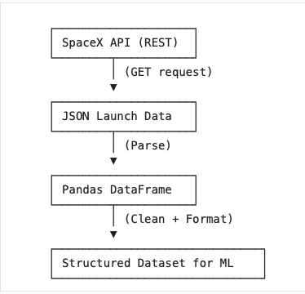
Data Collection – SpaceX API
Data Collection Process
Key Phrases:
API Integration: We used the SpaceX REST API to fetch launch data including flight number, payload, orbit, and landing outcome.
HTTP GET Request: A GET request was sent to the API endpoint using Python’s requests library.
JSON to DataFrame: The API response in JSON format was parsed and converted into a pandas DataFrame.
Initial Cleaning: Null values, irrelevant fields, and duplicates were filtered out to ensure consistency for downstream analysis.
https://github.com/linekardebu/firstRepo/blob/27a106d7948c5874b9ed175a1831cdecabff1fd0/jupyter-labs-spacex-data-collection-api.ipynb

Slide 8
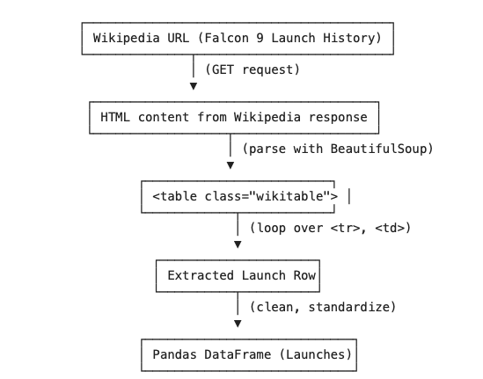
Data Collection - Scraping
Key Phrases for the Process
HTML Table Extraction: Used requests.get() to retrieve the webpage’s HTML content.
Parsing with BeautifulSoup: Parsed the HTML using BeautifulSoup to isolate all <table> tags with class "wikitable".
Data Transformation: Iterated over each row (<tr>) and cell (<td>/<th>), extracting structured records.
Data Cleaning: Applied formatting functions to convert date/time, payload, and outcome columns into clean, usable formats.
Conversion to DataFrame: All cleaned records were appended and converted into a Pandas DataFrame.
https://github.com/linekardebu/firstRepo/blob/3ae1c40bd07d739ba96d9ed4026da6e548306203/jupyter-labs-webscraping.ipynb

Slide 9
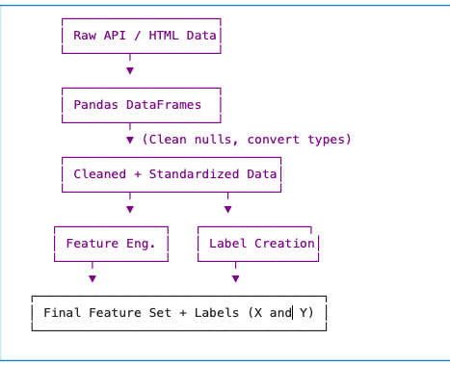
Data Wrangling
Key Phrases for Data Wrangling Process
Merging Sources: Combined launch metadata from the SpaceX API and web-scraped Wikipedia data into a single DataFrame.
Cleaning: Removed null values, standardized inconsistent formats (e.g., date/time), and dropped irrelevant columns.
Feature Extraction: Created new columns such as Landing Outcome, Payload Mass, Booster Version, and Orbit.
Encoding Categorical Variables: Applied one-hot encoding to variables like Launch Site, Orbit, and Serial.
Scaling Numerical Features: Used StandardScaler to normalize features like Payload Mass.
https://github.com/linekardebu/firstRepo/blob/a827ff0799249f6803046cc76eb152be3059b5d1/labs-jupyter-spacex-Data%20wrangling.ipynb

Slide 10
EDA with SQL
SQL Task Summary (SPACEXTBL)
Listed unique launch site names from the dataset.
Filtered booster versions that landed successfully on drone ships and carried payloads between 4000 and 6000 kg.
Counted the total number of successful and failed mission outcomes.
Identified booster versions that carried the maximum payload mass using a subquery.
Displayed records of failed drone ship landings in 2015, along with the month, booster version, and launch site.
Ranked landing outcomes by count within a specific date range (2010-06-04 to 2017-03-20), in descending order.
https://github.com/linekardebu/firstRepo/blob/1a19532e9c906db2f271e81ff4bfb493a9206d3d/jupyter-labs-eda-sql-coursera_sqllite.ipynb

Slide 11
EDA with Data Visualization
Plot Summaries
1. Flight Number vs Payload Mass (Colored by Class)
Use: Identifies if newer flights are carrying heavier payloads and whether that affects success.
2. Flight Number vs Launch Site (Colored by Class)
Use: Helps determine which sites are used more over time and their reliability.
3. Payload Mass vs Launch Site (Colored by Class)
Use: Useful for checking whether some sites are chosen for heavier or riskier launches.
4. Success Rate by Orbit Type
Use: Assesses whether certain orbit types are more prone to success or failure.
5. Flight Number vs Orbit (Colored by Class)
Use: Observes how orbit choice evolved over time and whether success improved.
6. Payload Mass vs Orbit (Colored by Class).
Use: Helps determine which orbits accommodate heavier payloads successfully.
7. Yearly Launch Success Trend
Use: Measures SpaceX’s improvement in launch reliability over time.
https://github.com/linekardebu/firstRepo/blob/1f241587b65d99cc1c1ab3fe61d9c4a8a0109e9c/edadataviz.ipynb

Slide 12
Build an Interactive Map with Folium
In the Interactive Visual Analytics lab using Folium, we created and added several types of map objects to enrich spatial understanding of SpaceX launch operations. Here’s a breakdown:
folium.Marker: Added standard pin-style markers for each individual launch event.
To mark the exact coordinates of each launch.
Used color-coded icons: 🟢 green for successful (Class=1), 🔴 red for failed launches (Class=0).
Helped visualize success patterns across different launch sites.
folium.Circle: Circular overlays drawn around each launch site location.
To highlight and group launch sites visually on the map.
Enhanced site visibility, especially when zoomed out.
folium.PolyLine: Lines connecting launch sites to various proximities: Nearest coastline, Highway, Railway & City
To analyze how proximity to infrastructure or geography could affect site selection or success rates.
Visually connected spatial relationships between launch points and surrounding features.
folium.features.DivIcon: Custom HTML-based icons showing distance in kilometers near proximity markers.
To display calculated distances (e.g., to coast or city) directly on the map.
Enabled users to interpret spatial proximity without checking separate tables or charts.
https://github.com/linekardebu/firstRepo/blob/36fc67ee4e92ad2b1a166c8f098497290d43851e/lab_jupyter_launch_site_location.ipynb

Slide 13
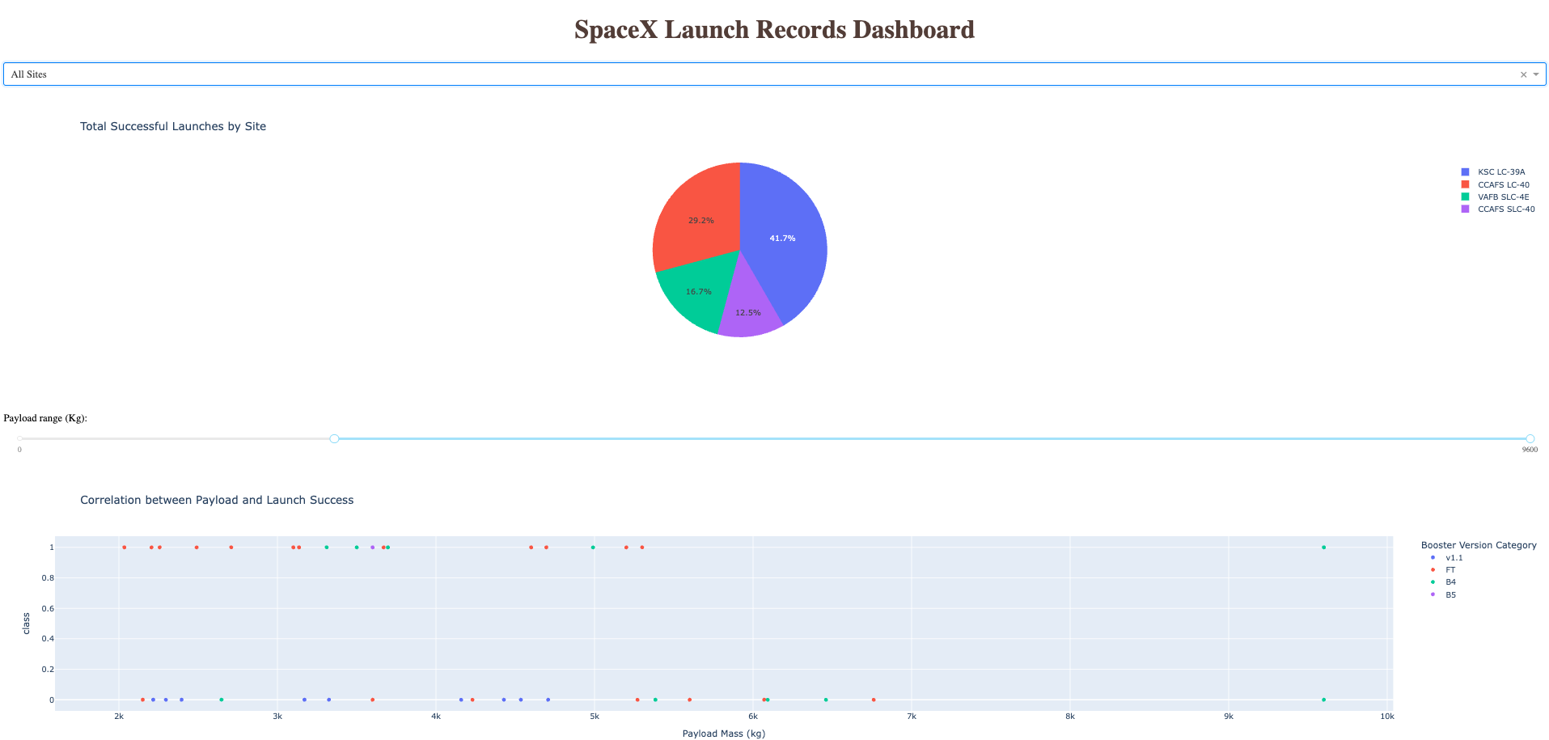
Build a Dashboard with Plotly Dash

Slide 14
Build a Dashboard with Plotly Dash
Pie Chart (success-pie-chart):
Displays total successful launches for each site when "All Sites" is selected.
Displays success vs. failure counts for a specific site when that site is selected from the dropdown.
Scatter Plot (success-payload-scatter-chart):
Shows the correlation between payload mass and launch success.
Colored by Booster Version Category for additional insight.
Dynamically updates based on launch site selection and payload range.
Dropdown Menu (site-dropdown):
Enables selection of a specific launch site or "All Sites".
Drives the dynamic content in both the pie chart and the scatter plot.
Range Slider (payload-slider):
Lets users filter data by selecting a range of payload mass (in kilograms).
Affects the data displayed in the scatter plot.
https://github.com/linekardebu/firstRepo/blob/22202ad66e03875c649624c0959e857d2cdd0bfe/spacex-dash-app.py

Slide 15
Predictive Analysis (Classification)
Model Development Summary
Step 1: Data Preprocessing
Used OneHotEncoder for categorical variables like launch site and booster version.
Applied StandardScaler for feature normalization.
Split data into training and testing sets using train_test_split.
Step 2: Model Building
Four classification algorithms were trained: Logistic Regression, Support Vector Machine (SVM), Decision Tree Classifier & K-Nearest Neighbors (KNN)
Each model was trained using the processed features to predict launch success.
Step 3: Evaluation
Models were evaluated using:
Accuracy Score
Confusion Matrix
Classification Report (Precision, Recall, F1-score)
Step 4: Hyperparameter Tuning
Used GridSearchCV to tune:
C and kernel for SVM
max_depth for Decision Trees
n_neighbors for KNN
Step 5: Best Model Selection
Compared performance metrics across all models.
Support Vector Machine (SVM) with optimal hyperparameters gave the best accuracy and balanced performance.
https://github.com/linekardebu/firstRepo/blob/4f9635b222a7ccbb009fe0e8208d53ea3c11eb9a/SpaceX_Machine%20Learning%20Prediction_Part_5.ipynb

Slide 16
Results
Interactive analytics demo in screenshots

Slide 17
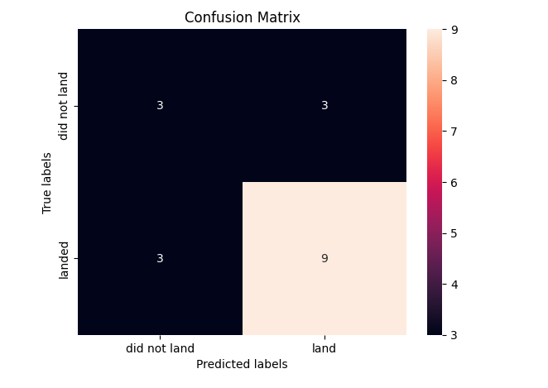
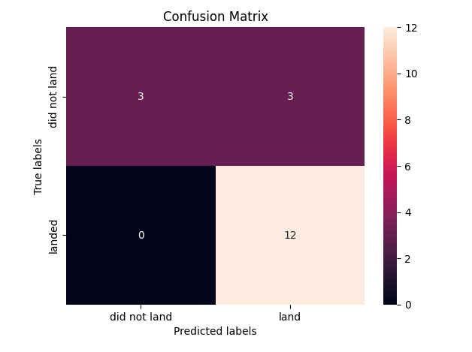
Results
Predictive analysis results
Decision Tree Confusion Matrix KNN Confusion Matrix

Slide 18

Section 2

Slide 19
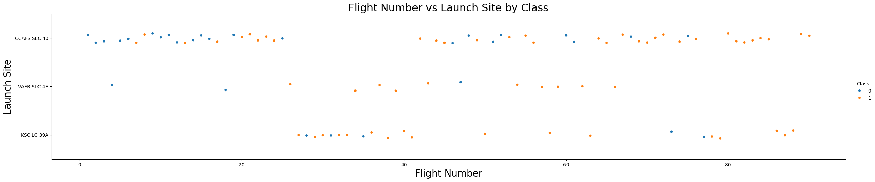
Flight Number vs. Launch Site
This scatter plot helps us:
Visually compare launch success rates across different sites.
Identify trends over time (e.g., improved performance with higher flight numbers).
Spot site-specific reliability or performance differences.

Slide 20
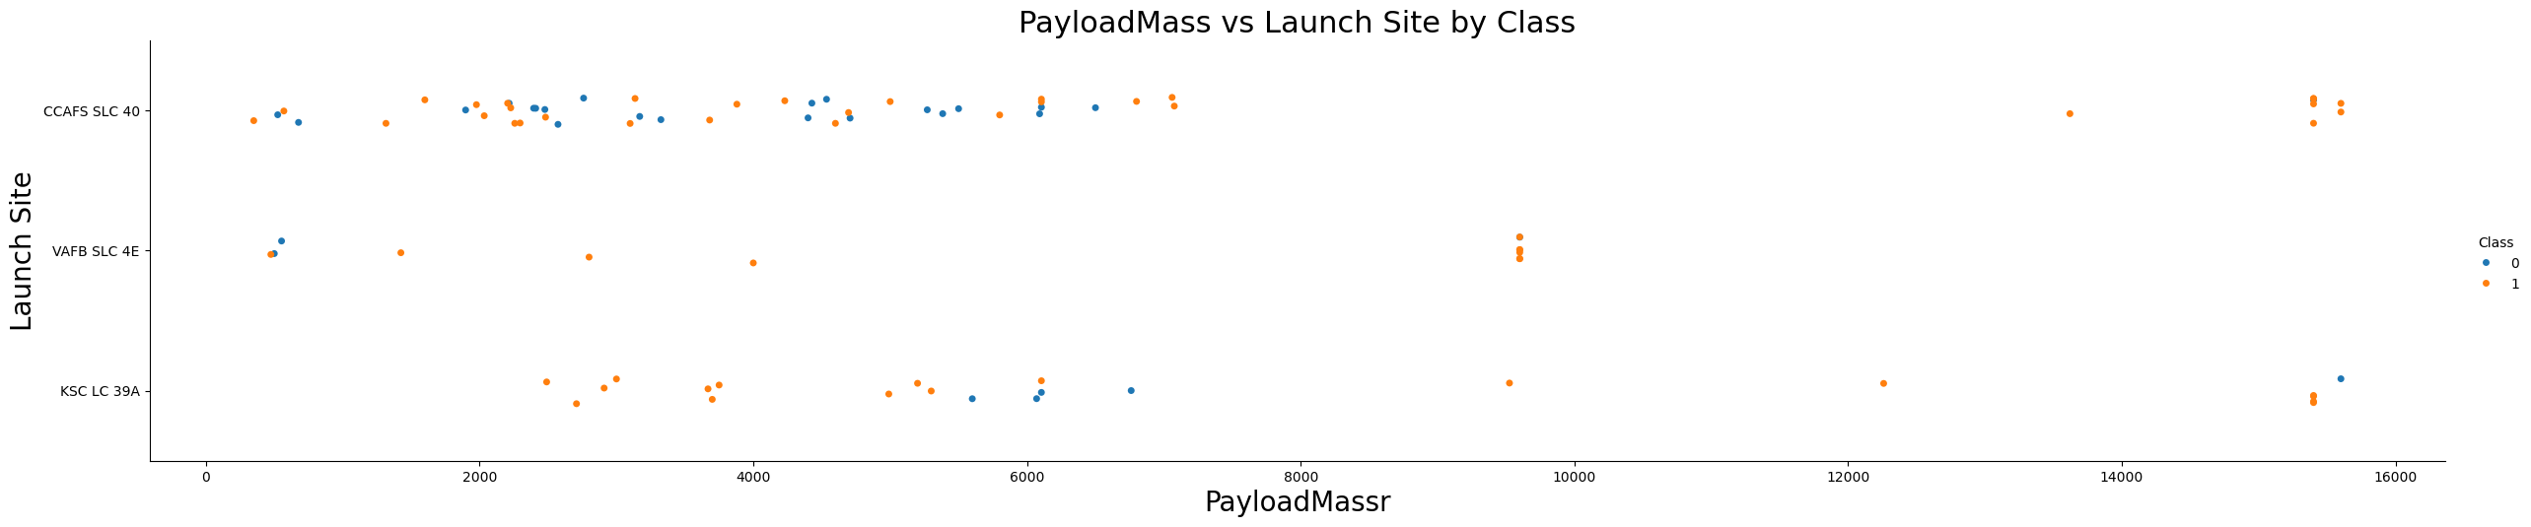
Payload vs. Launch Site
This plot helps analyze how payload mass impacts launch outcomes across different sites.
Site-specific capabilities (e.g., KSC handles heavier payloads).
Potential link between payload size and success rate at certain sites.
Valuable for planning future launches based on site and payload capacity.

Slide 21
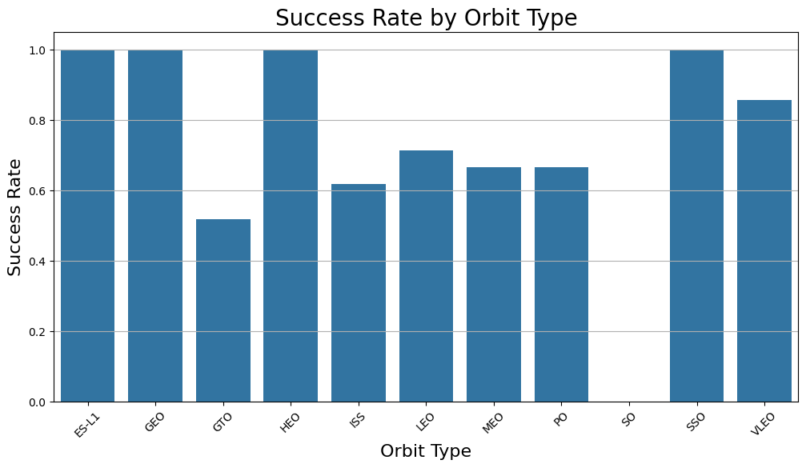
Success Rate vs. Orbit Type
This bar chart helps identify reliable orbital destinations and highlights potential risk areas:
GTO may need further investigation or technology refinement.
Launches to ES-L1, NEO, and SSO are consistently reliable, making them optimal for mission planning.

Slide 22
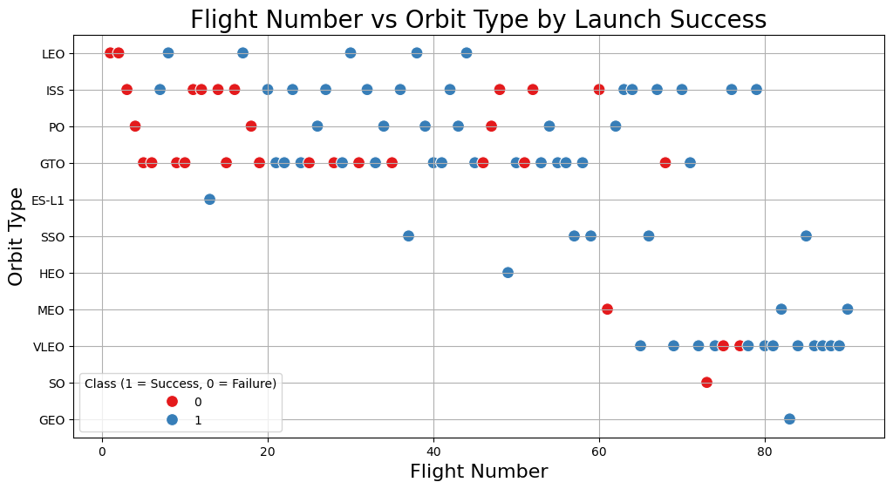
Flight Number vs. Orbit Type
This plot effectively visualizes how SpaceX's launch success evolved over time and how certain orbit types posed higher challenges in early stages.
It also highlights the company’s technological maturity in handling a variety of orbital missions as experience accumulated.

Slide 23
Payload vs. Orbit Type
Show a scatter point of payload vs. orbit type
Show the screenshot of the scatter plot with explanations

Slide 24
Launch Success Yearly Trend
Show a line chart of yearly average success rate
Show the screenshot of the scatter plot with explanations

Slide 25
All Launch Site Names
Find the names of the unique launch sites
Present your query result with a short explanation here

Slide 26
Launch Site Names Begin with 'CCA'
Find 5 records where launch sites begin with `CCA`
Present your query result with a short explanation here

Slide 27
Total Payload Mass
Calculate the total payload carried by boosters from NASA
Present your query result with a short explanation here

Slide 28
Average Payload Mass by F9 v1.1
Calculate the average payload mass carried by booster version F9 v1.1
Present your query result with a short explanation here

Slide 29
First Successful Ground Landing Date
Find the dates of the first successful landing outcome on ground pad
Present your query result with a short explanation here

Slide 30
Successful Drone Ship Landing with Payload between 4000 and 6000
List the names of boosters which have successfully landed on drone ship and had payload mass greater than 4000 but less than 6000
Present your query result with a short explanation here

Slide 31
Total Number of Successful and Failure Mission Outcomes
Calculate the total number of successful and failure mission outcomes
Present your query result with a short explanation here

Slide 32
Boosters Carried Maximum Payload
List the names of the booster which have carried the maximum payload mass
Present your query result with a short explanation here

Slide 33
2015 Launch Records
List the failed landing_outcomes in drone ship, their booster versions, and launch site names for in year 2015
Present your query result with a short explanation here

Slide 34
Rank Landing Outcomes Between 2010-06-04 and 2017-03-20
Rank the count of landing outcomes (such as Failure (drone ship) or Success (ground pad)) between the date 2010-06-04 and 2017-03-20, in descending order
Present your query result with a short explanation here

Slide 35

Section 3

Slide 36
<Folium Map Screenshot 1>
Replace <Folium map screenshot 1> title with an appropriate title
Explore the generated folium map and make a proper screenshot to include all launch sites’ location markers on a global map
Explain the important elements and findings on the screenshot

Slide 37
<Folium Map Screenshot 2>
Replace <Folium map screenshot 2> title with an appropriate title
Explore the folium map and make a proper screenshot to show the color-labeled launch outcomes on the map
Explain the important elements and findings on the screenshot

Slide 38
<Folium Map Screenshot 3>
Replace <Folium map screenshot 3> title with an appropriate title
Explore the generated folium map and show the screenshot of a selected launch site to its proximities such as railway, highway, coastline, with distance calculated and displayed
Explain the important elements and findings on the screenshot

Slide 39

Section 4

Slide 40
<Dashboard Screenshot 1>
Replace <Dashboard screenshot 1> title with an appropriate title
Show the screenshot of launch success count for all sites, in a piechart
Explain the important elements and findings on the screenshot

Slide 41
<Dashboard Screenshot 2>
Replace <Dashboard screenshot 2> title with an appropriate title
Show the screenshot of the piechart for the launch site with highest launch success ratio
Explain the important elements and findings on the screenshot

Slide 42
<Dashboard Screenshot 3>
Replace <Dashboard screenshot 3> title with an appropriate title
Show screenshots of Payload vs. Launch Outcome scatter plot for all sites, with different payload selected in the range slider
Explain the important elements and findings on the screenshot, such as which payload range or booster version have the largest success rate, etc.

Slide 43

Section 5

